Slide 1
Reproductive rights in the context of the COVID-19 pandemic in Latin America
Sonia Ariza Navarrete & Agustina Ramón Michel
Latin America

Slide 2
Disclosures
Commercial Interest | Relationship(s)
None | None
None | None

Slide 3




Reproductive rights in the context of the COVID-19 pandemic in Latin America
"Reproductive Health is Vital”
Sonia Ariza Navarrete & Agustina Ramón Michel
No conflicting interests
FIGO-August, 2021

Slide 4
Background - context
Disarticulated, segmented and precarious Latin American health systems.
Poor access to sexual and reproductive health services before the pandemic.
Isolation meassures in unequal conditions.
Responses to the pandemic crisis:
  Focused solely on COVID-19 with highly restricted access to primary care level.
  Measures did not consider adverse effects on women, and certain groups.
Organized groups opposed to sexual and reproductive rights took advantage of the pandemic.
Social mobilization in favor of legal abortion in several countries.
Notes:
1 m.

Slide 5
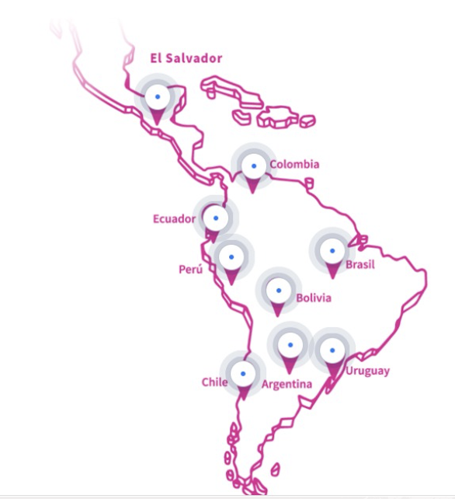
The Research
Scope:
9 countries
Research period:
March to September 2020
Notes:
10 seg

Slide 6
The Research
Focus of research
Perinatal care
Contraception
Abortion
Type of data
Real-time data gadering
Various of reliable sources
National alliances
Essential RHS
Qualitative and quantitative
Notes:
30 seg

Slide 7
Methodology
Indicators
Structural indicators: they measure the acceptance and commitment of the State, through the adoption of laws and policies to respect and uphold the rights associated with RH during the pandemic.
Process indicators: they measure the State's ongoing efforts to transform legal and political commitments into the desired outcomes in RH during the pandemic.
Outcome indicators: they document the effects of structural and process initiatives aimed at respecting, protecting and ensuring essential RH services.
Notes:
30 seg

Slide 8
Findings
Recognition of reproductive health as essential and urgent in 6 of the 9 countries studied, as follows:
  Full recognition: Argentina, Colombia
  Partial recognition (without abortion): Bolivia, Ecuador, Peru, Uruguay
  Unrecognized: El Salvador and Chile
  Recognition rejected: Brazil.
However, all countries restricted access and showed health outcomes that indicate the lack of priority given to these reproductive health services.
Notes:
30 seg

Slide 9
Findings
Reproductive health is susceptible to access to quality and timely services. Therefore, the impact of restriction of these services immediately translates into a variation in maternal and neonatal morbidity and mortality.
Source: Brazil (INE, from January to June): Chile (INE, January to September);
Ecuador (MSP - epidemiological gazette, January to September); Peru (ENDES, January to June)
Notes:
30 seg

Slide 10
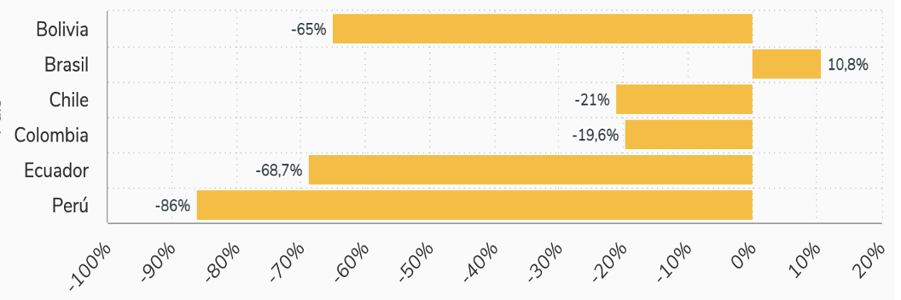
Findings
Examples of access to reproductive health services:
Due to restrictions on reproductive health care and the prevalence of sexual violence during the pandemic the demand for this service was expected to increase. However, except for Brazil, all countries show a decrease in the number of legal abortions performed.
Access to abortion variation 2019 -2020
Notes:
1 m.

Slide 11
Findings: good practices in abortion
  Provision of voluntary/legal termination of pregnancy by telemedicine
  Provision of early abortion services in all levels of complexity
  Flexibility of requirements for abortion services
      Electronic prescription, access to first consultation.
  Public/private collaboration for the improvement of policies and access
  Work and planning sessions: Chile.
      Provision of services and counseling: Ecuador, Argentina, Colombia.
Notes:
1 min

Slide 12
Discussion
The pandemic as a catalyst of changes and resistances: abortion
Countries that facilitated access to abortion in the pandemic were those already doing it, such as Colombia and Argentina.
Countries that limited access to this practice.
  Brazil (rape claim and report of cases to be investigated).
  Ecuador and Peru (limited access to outpatient practices and appointments).
  Bolivia (negative COVID test to enter any health facility).
Countries that maintained unnecessary limits to access abortion services.
  Chile, Peru, Brazil (hospitalization).
  Uruguay (waiting time and minimum residence of 1 year).
  Ecuador (ethics committee).
Notes:
1 min

Slide 13
Conclusions
Rigorous social monitoring contributed during a crucial time: it shows barriers and, above all, good practices to put in place even after the pandemic.
There was a significant impact on reproductive health during the pandemic:
  Increase in maternal mortality.
  Decrease in the number of controls in pregnancy.
  Increased number of unplanned out-of-hospital deliveries (up to 30%).
  Decrease in access to safe abortion (by up to 86%).
The pandemic was a catalyst for changes and resistance: flexibility and willingness to meet reproductive needs as well as the existing resistance intensified.
Good practices are possible, concrete, and cost-effective, they could be replicated.
Notes:
1m.

Slide 14
Thank you

